Slide 1
Number Sequences

Slide 2
This Lecture
We will study some simple number sequences and their properties.
The topics include:
Representation of a sequence
Sum of a sequence
  Arithmetic sequence
  Geometric sequence
    Applications
  Harmonic sequence
Product of a sequence
  Factorial

Slide 3
Number Sequences
In general a number sequence is just a sequence of numbers
a₁, a₂, a₃, …, a_{n} (it is an infinite sequence if n goes to infinity).
We will study sequences that have interesting patterns.
e.g. a_{i} = i
1, 2, 3, 4, 5, …
a_{i} = i²
1, 4, 9, 16, 25, …
a_{i} = 2^{i}
2, 4, 8, 16, 32, …
a_{i} = (-1)^{i}
-1, 1, -1, 1, -1, …
a_{i} = i/(i+1)
1/2, 2/3, 3/4, 4/5, 5/6, …

Slide 4
Finding General Pattern
Given a number sequence, can you find a general formula for its terms?
a₁, a₂, a₃, …, a_{n}, …
General formula
1/4, 2/9, 3/16, 4/25, 5/36, …
1/3, 2/9, 3/27, 4/81, 5/243,…
0, 1, -2, 3, -4, 5, …
1, -1/4, 1/9, -1/16, 1/25, …
a_{i} = i/(i+1)²
a_{i} = i/3^{i}
a_{i} = (i-1)·(-1)^{i}
a_{i} = (-1)^{i+1} / i²

Slide 5
Recursive Definition
We can also define a sequence by writing the relations between its terms.
e.g.
1 when i=1
a_{i} =
1, 3, 5, 7, 9, …, 2n+1, …
a_{i-1}+2 when i>1
1 when i=1
General Formula
1, 2, 4, 8, 16, …, 2^{n}, …
a_{i} =
2a_{i-1} when i>1
1 when i=1 or i=2
Fibonacci sequence
a_{i} =
a_{i-1}+a_{i-2} when i>2
1, 1, 2, 3, 5, 8, 13, 21, …, ??, …
Will compute its general formula in a later lecture.

Slide 6
Proving a Property of a Sequence
What is the n-th term of this sequence?
3 when i=1
a_{i} =
(a_{i-1})² when i>1
Step 1: Computing the first few terms, 3, 9, 81, 6561, …
n
Step 2: Guess the general pattern, 3, 3², 3⁴, 3⁸, …, 3² ? ,…
Step 3: Prove by induction that a_{i}=3²
i-1
Base case: a₁=3
i-1
i
Induction step: assume a_{i}=3² , prove a_{i+1}=3²
i-1
i
a_{i+1} = (a_{i})² = (3² )² =3²

Slide 7
This Lecture
Representation of a sequence
Sum of a sequence
  Arithmetic sequence
  Geometric sequence
    Applications
  Harmonic sequence
  The integral method
Product of a sequence
  Factorial

Slide 8
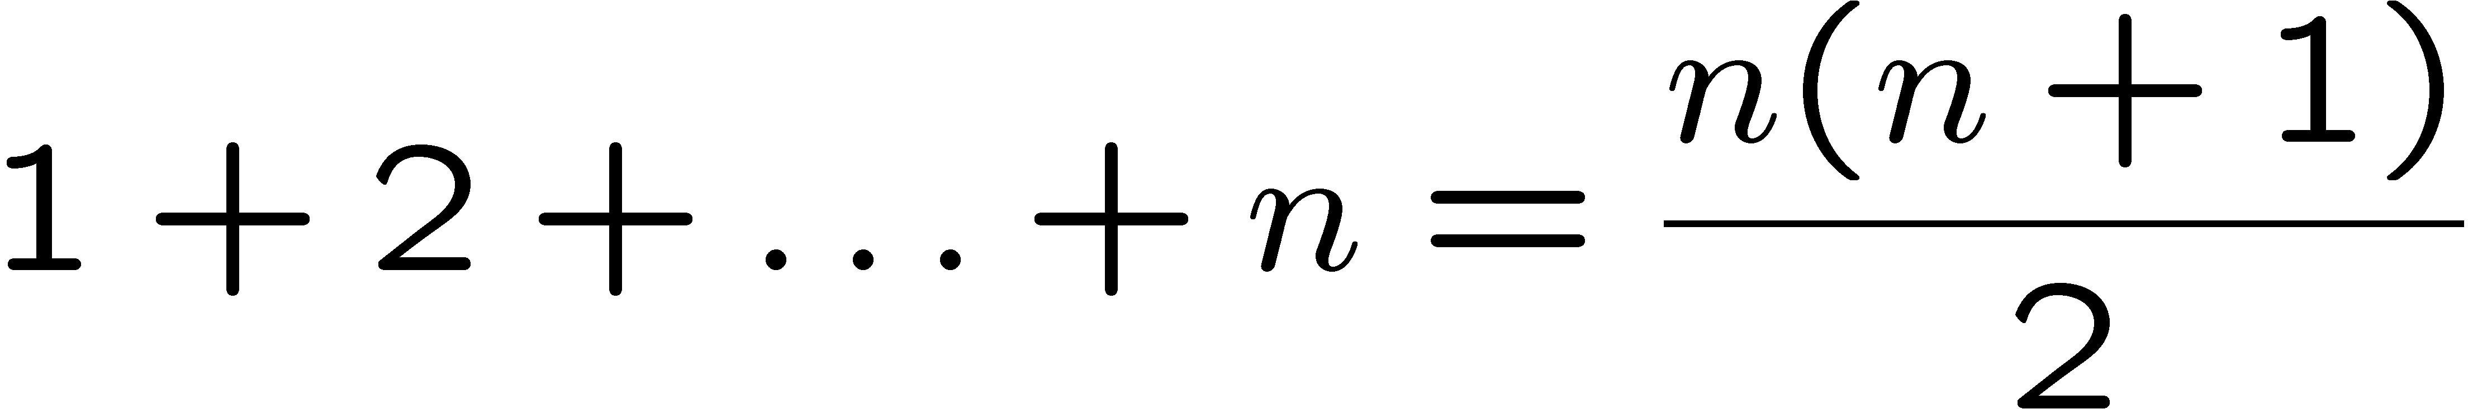
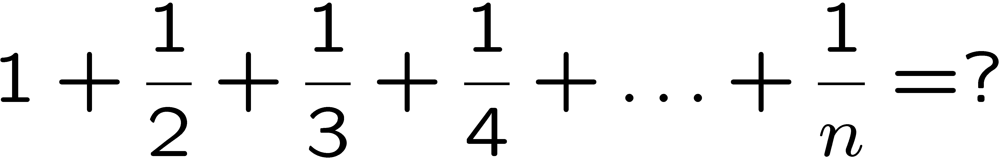
Sum of a Sequence
We have seen how to prove these equalities by induction,
but how do we come up with the right hand side?

Slide 9
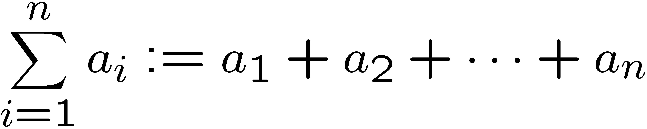
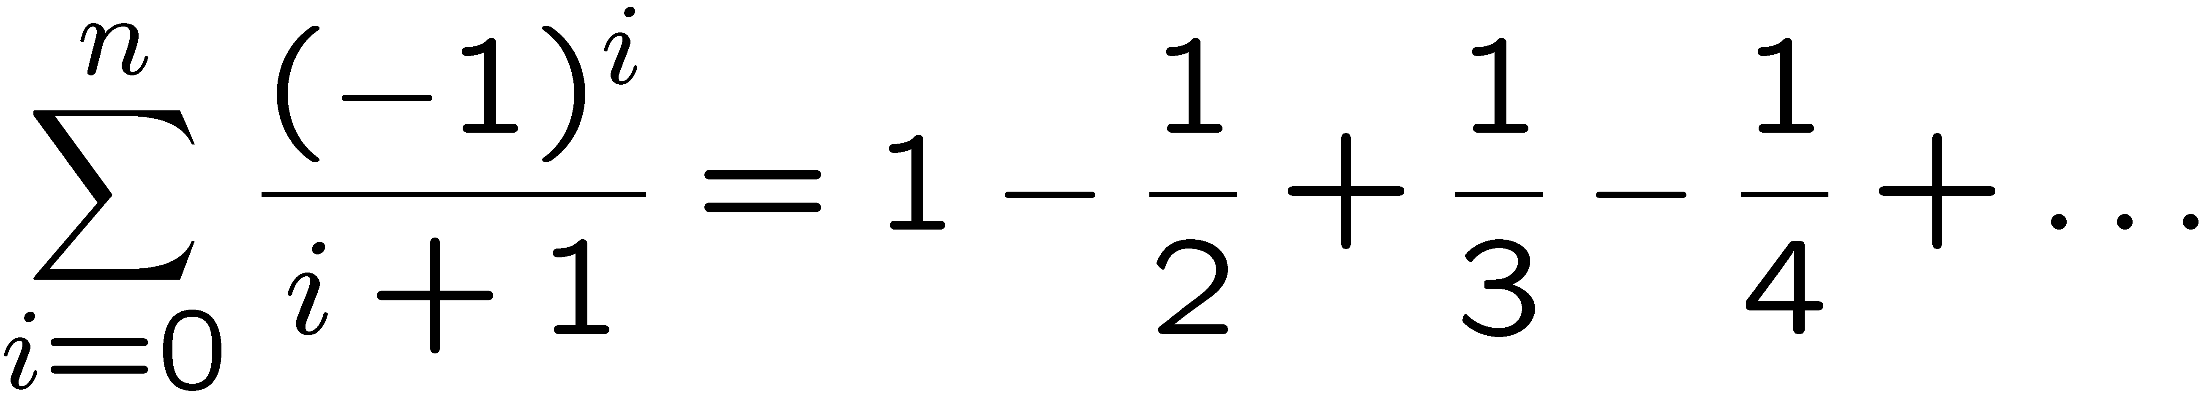
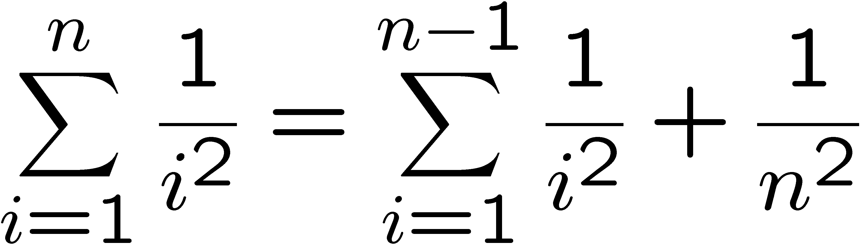
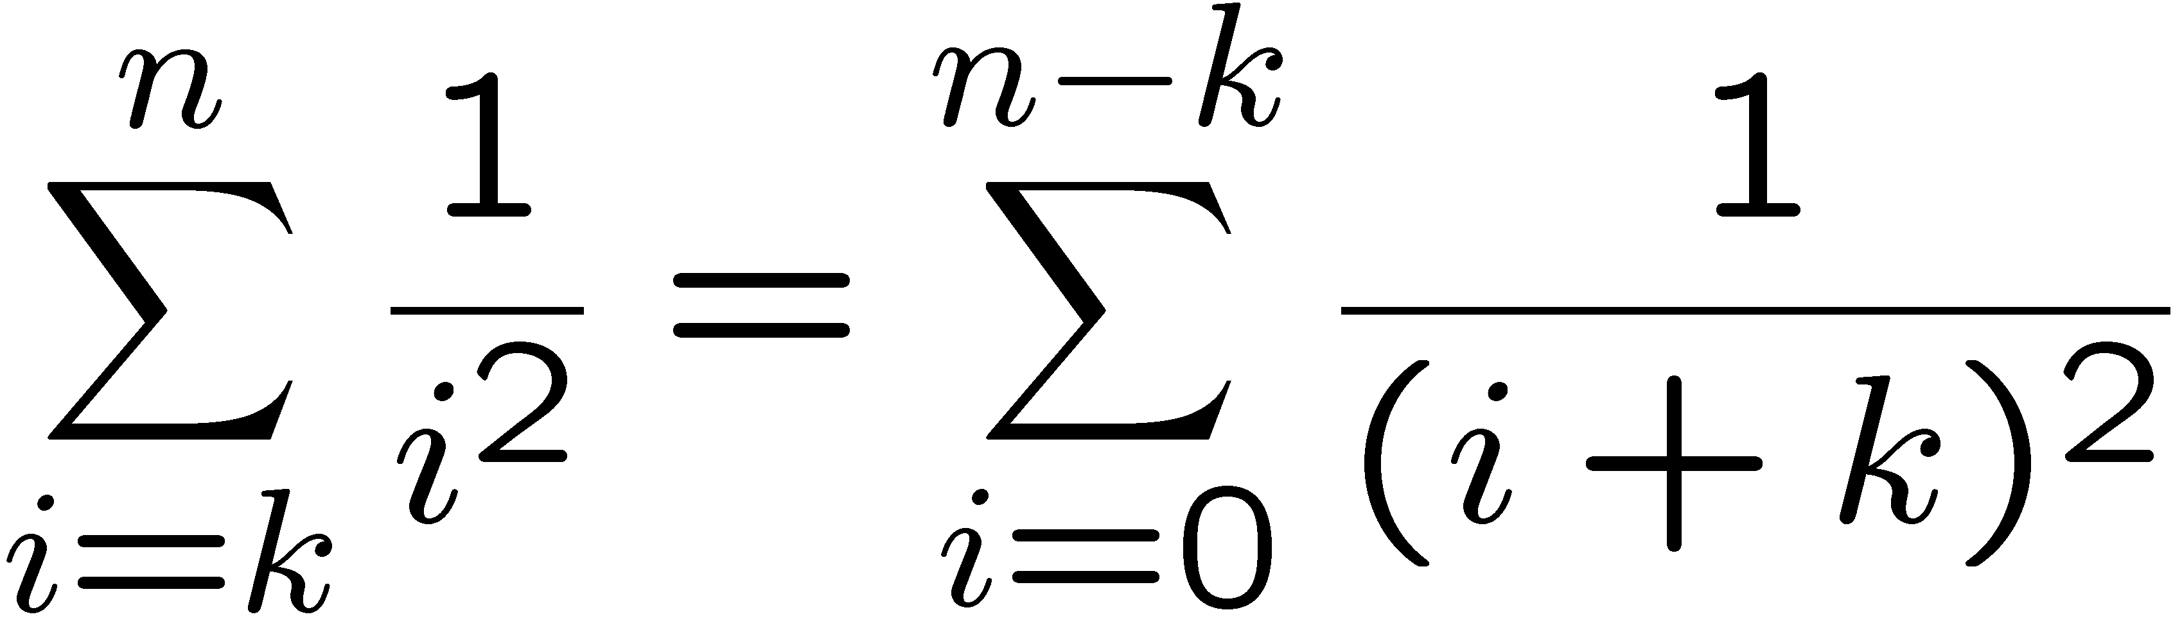
Summation
(adding or subtracting from a sequence)
(change of variable)

Slide 10
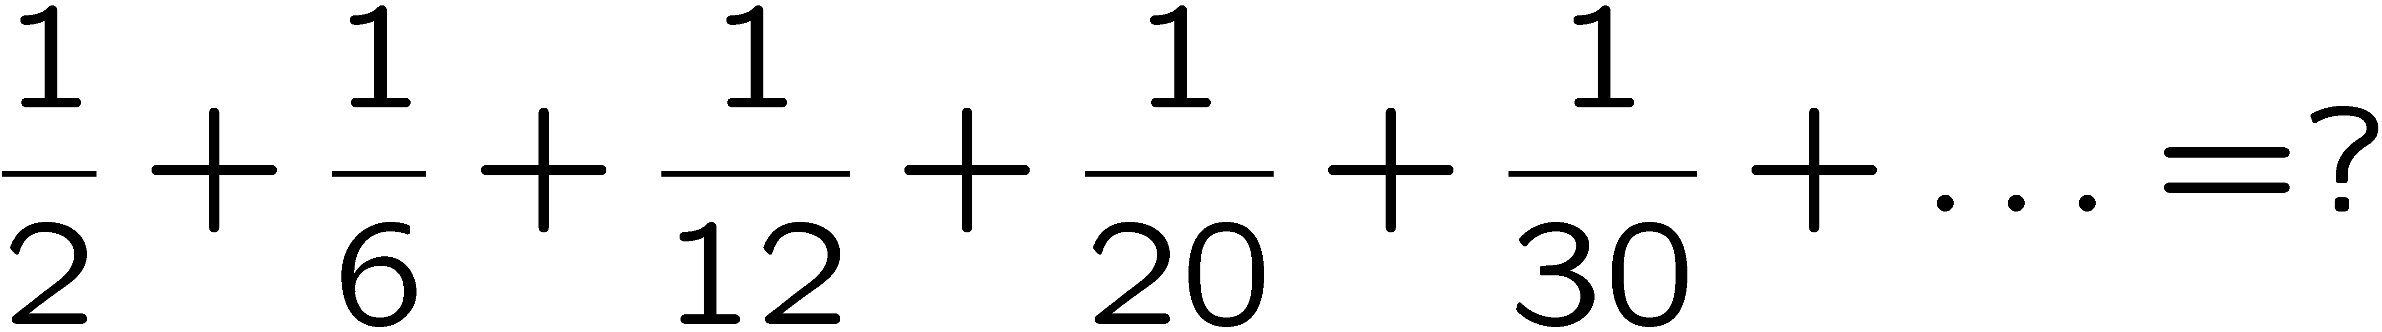

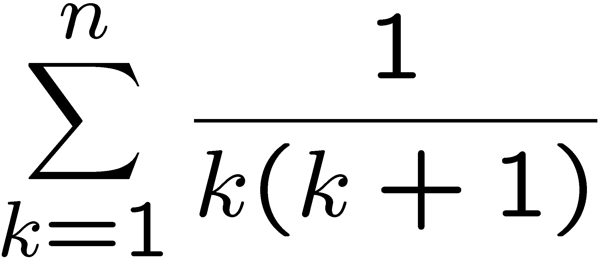
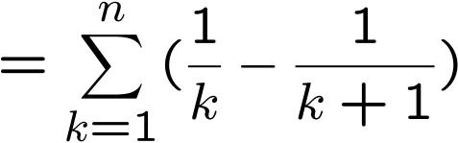
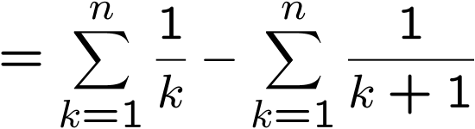
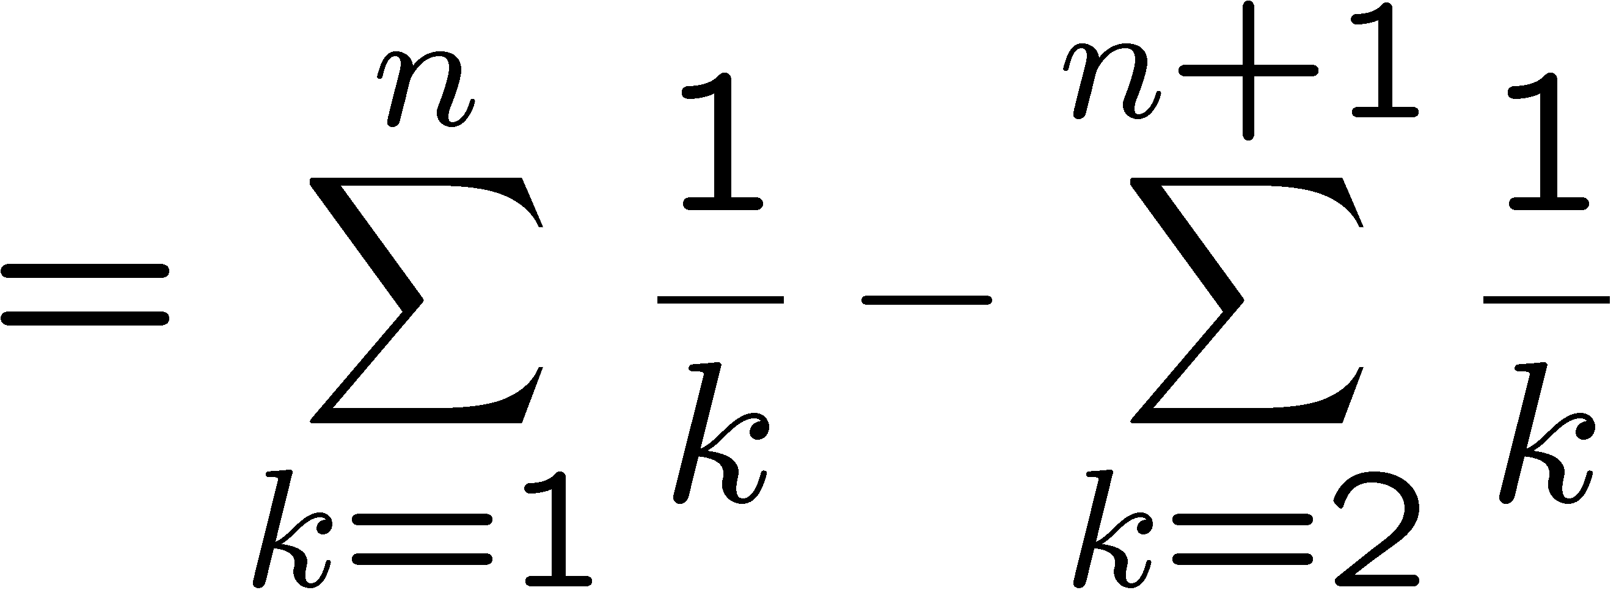
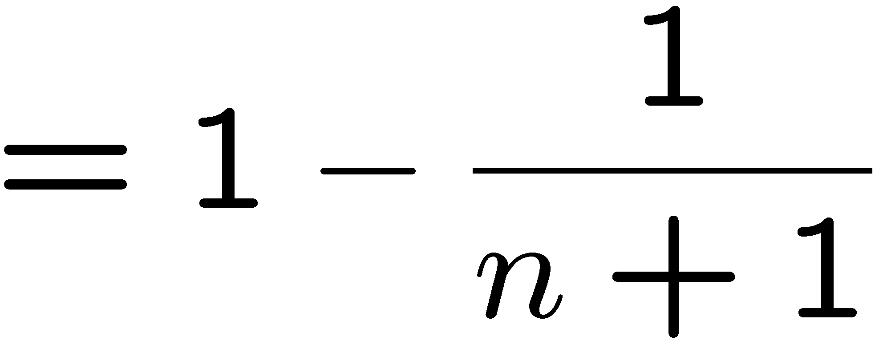
A Telescoping Sum
Step 1: Find the general pattern.
a_{i} = 1/i(i+1)
Step 2: Manipulate the sum.
(partial fraction)
(change of variable)

Slide 11
This Lecture
Representation of a sequence
Sum of a sequence
  Arithmetic sequence
  Geometric sequence
    Applications
  Harmonic sequence
  The integral method
Product of a sequence
  Factorial

Slide 12
Sum for Children
89 + 102 + 115 + 128 + 141 +
154 + ··· +
193 + ··· +
232 + ··· +
323 + ··· +
414 + ··· + 453 + 466
Nine-year old Gauss saw
30 numbers, each 13 greater than the previous one.
1st + 30th = 89 + 466 = 555
2nd + 29th =
(1st+13) + (30th−13) = 555
3rd + 28th =
(2nd+13) + (29th−13) = 555
So the sum is equal to 15x555 = 8325.

Slide 13
Arithmetic Sequence
A number sequence is called an arithmetic sequence if a_{i+1} = a_{i}+d for all i.
e.g. 1,2,3,4,5,… 5,3,1,-1,-3,-5,-7,…
What is the formula for the n-th term?
a_{i+1} = a₁ + i·d
(can be proved by induction)
What is the formula for the sum S=1+2+3+4+5+…+n?
Write the sum S = 1 + 2 + 3 + … + (n-2) + (n-1) + n
Write the sum S = n + (n-1) + (n-2) + … + 3 + 2 + 1
Adding terms following the arrows, the sum of each pair is n+1.
We have n pairs, and therefore 2S = n(n+1), and thus S = n(n+1)/2.

Slide 14
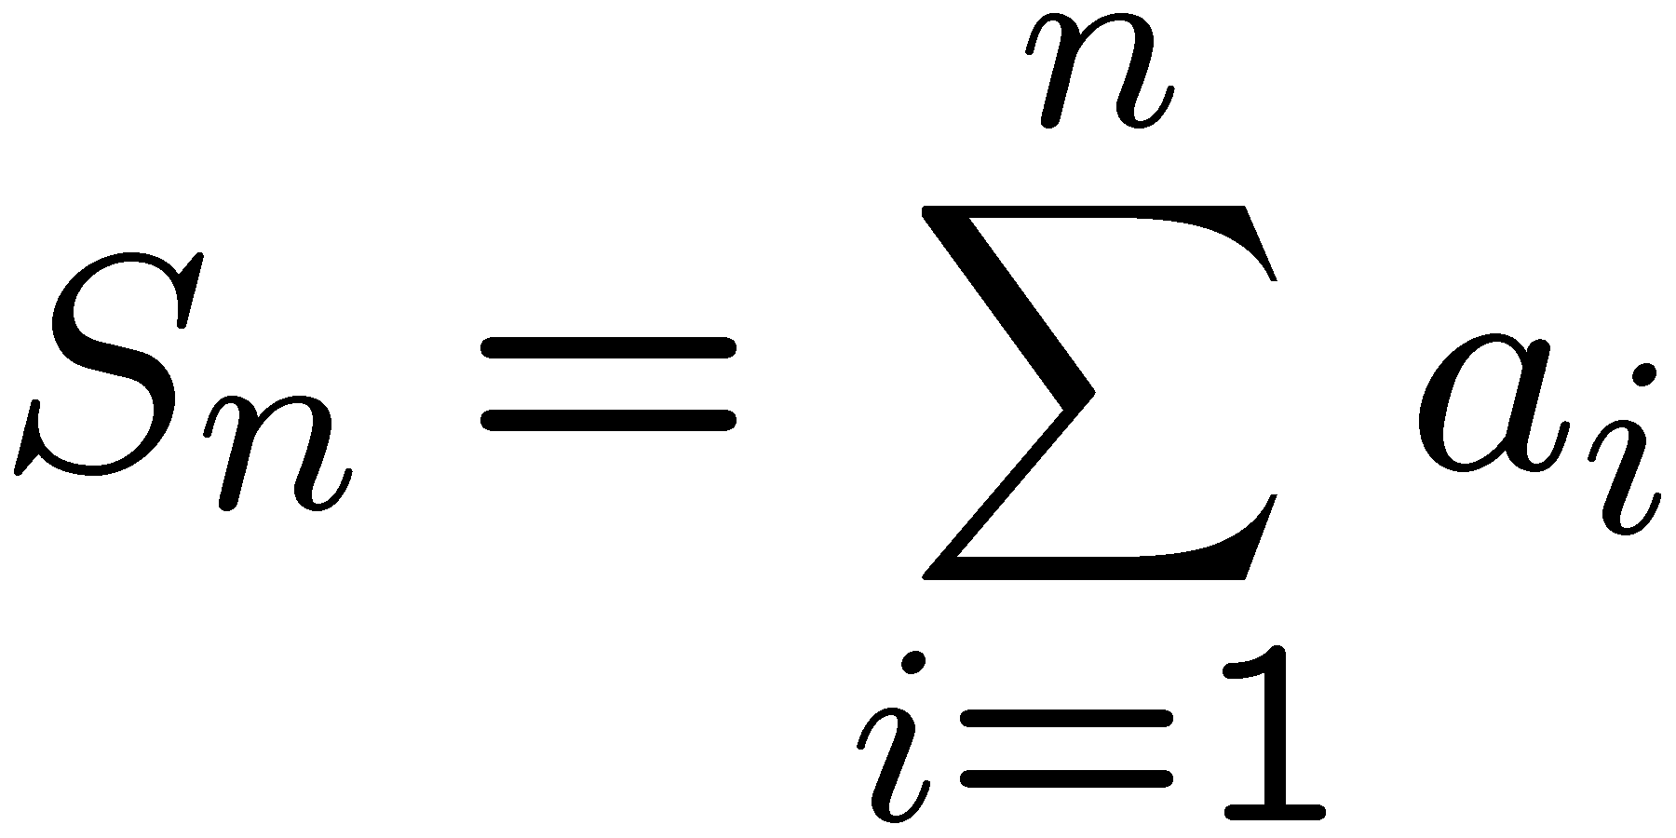
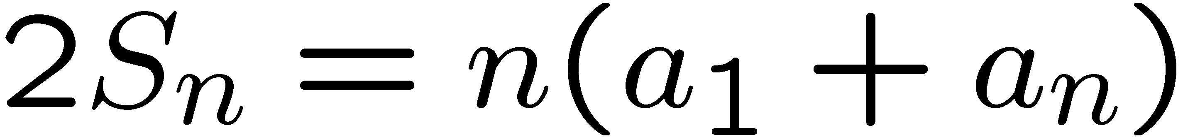
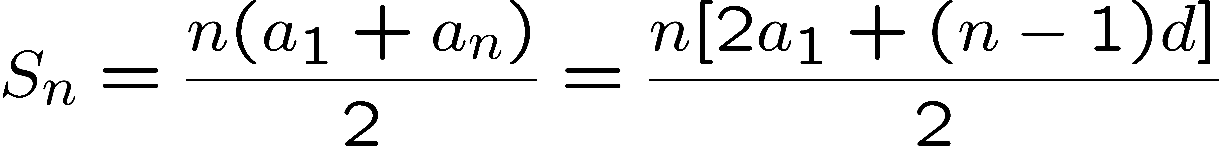
Arithmetic Sequence
A number sequence is called an arithmetic sequence if a_{i+1} = a_{i}+d for all i.
What is a simple expression of the sum?
Adding the equations together gives:
Rearranging and remembering that a_{n} = a₁ + (n − 1)d, we get:

Slide 15
This Lecture
Representation of a sequence
Sum of a sequence
  Arithmetic sequence
  Geometric sequence
    Applications
  Harmonic sequence
  The integral method
Product of a sequence
  Factorial

Slide 16
Geometric Sequence
A number sequence is called a geometric sequence if a_{i+1} = r·a_{i} for all i.
e.g. 1, 2, 4, 8, 16,… 1/2, -1/6, 1/18, -1/54, 1/162, …
What is the formula for the n-th term?
a_{i+1} = r^{i}·a₁
(can be proved by induction)
What is the formula for the sum S=1+3+9+27+81+…+3^{n}?
Write the sum S = 1 + 3 + 9 + … + 3^{n-2} + 3^{n-1} + 3^{n}
Write the sum 3S = 3 + 9 + … + 3^{n-2} + 3^{n-1} + 3^{n} + 3^{n+1}
Subtracting the first equation from the second equation,
we have 2S = 3^{n+1} - 1, and thus S = (3^{n+1} – 1)/2.

Slide 17
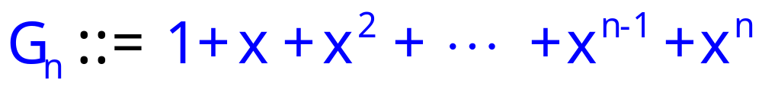
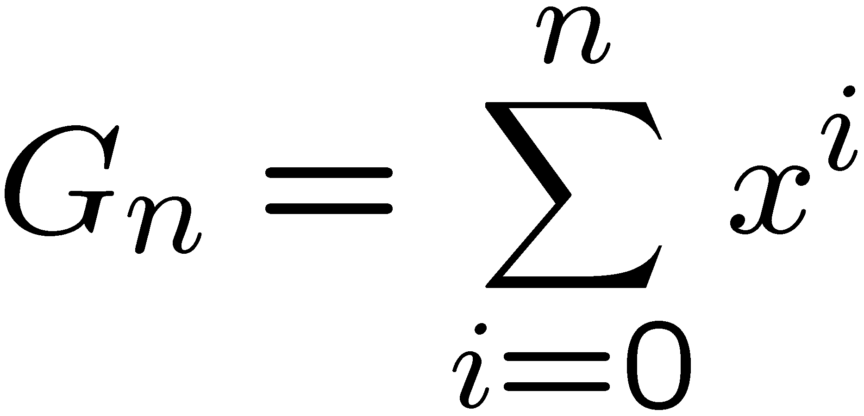
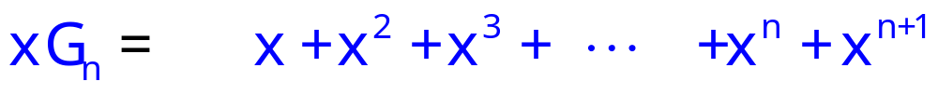
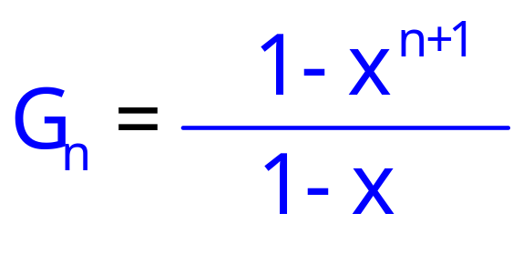
Geometric Series
What is a simple expression of G_{n}?
G_{n}−xG_{n}=
1
− x^{n+1}

Slide 18
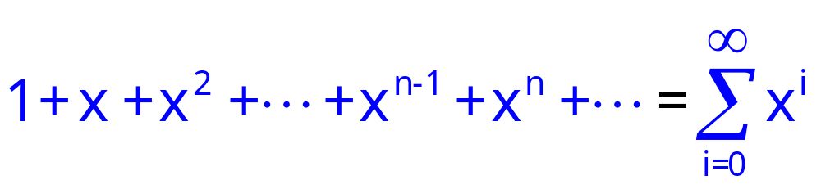
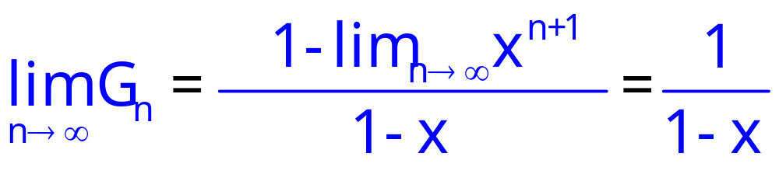
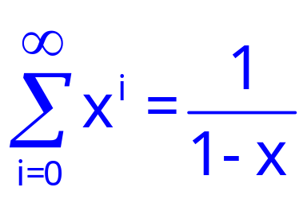
Infinite Geometric Series
Consider infinite sum (series)
for |x| < 1
for |x| < 1

Slide 19
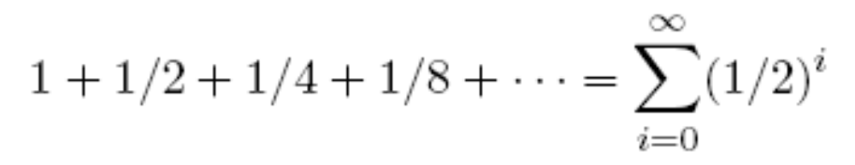

Some Examples
for |x| < 1
x = ½ < 1

Slide 20


Some Examples
for |x| < 1
1 (Can you prove this?)
x = 1/10 < 1

Slide 21

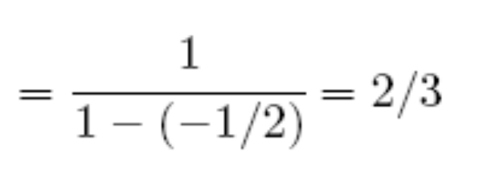
Some Examples
for |x| < 1
|x| = |-1/2| < 1

Slide 22
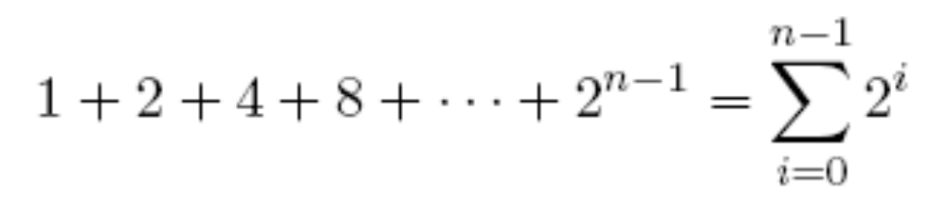
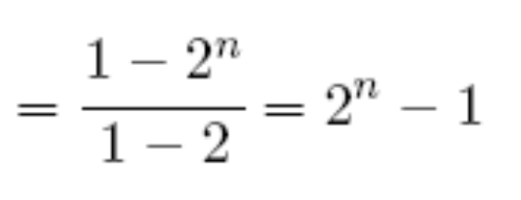
Some Examples
x = 2

Slide 23
Prove: If 2^{n}-1 is prime, then n is prime.
Contrapositive:
P ⇒ q ≡ ~q ⇒ ~p
Prove the contrapositive: If n is composite, then 2^{n}-1 is composite.
Note that 2^{n}-1=1+2+…+2^{n-1}
How?

Slide 24
Prove: If 2^{n}-1 is prime, then n is prime.
Prove the contrapositive: If n is composite, then 2^{n}-1 is composite.
Note that 2^{n}-1=1+2+…+2^{n-1}
Let n=pq
Then 2^{pq} – 1 = 1 + 2 + … + 2^{pq-1} and the sequence has pq terms.
Put q consecutive numbers into one group, then we have exactly p groups.
2⁰ + 2¹ + … + 2^{(q-1)}
+ 2^{q} + 2^{q+1} + … + 2^{q+(q-1)}
+ 2^{2q} + 2^{2q+1} + … + 2^{2q+(q-1)}
+ 2^{3q} + 2^{3q+1} + … + 2^{3q+(q-1)}
^{+ …}
In General, the ith group=
2^{(i-1)q} + 2^{(i-1)q+1} + … + 2^{(i-1)q+(q-1)}

Slide 25
Prove: If 2^{n}-1 is prime, then n is prime.
Prove the contrapositive: If n is composite, then 2^{n}-1 is composite.
Note that 2^{n}-1=1+2+…+2^{n-1}
Let n=pq
Then 2^{pq} – 1 = 1 + 2 + … + 2^{pq-1} and the sequence has pq terms.
Put q consecutive numbers into one group, then we have exactly p groups.
The i-th group is equal to 2^{(i-1)q} + 2^{(i-1)q+1} + … + 2^{(i-1)q+(q-1)}.
So the i-th group is equal to 2^{(i-1)q} (1 + 2 + … + 2^{q-1})
So the whole sequence is equal to (1 + 2 + … + 2^{q-1})(1 + 2^{q} + 2^{2q} + … 2^{(p-1)q}).
A Composite Number

Slide 26
This Lecture
Representation of a sequence
Sum of a sequence
  Arithmetic sequence
  Geometric sequence
    Applications
  Harmonic sequence
  The integral method
Product of a sequence
  Factorial

Slide 27
The Value of an Annuity
Would you prefer a million dollars today
or $50,000 a year for the rest of your life?
An annuity is a financial instrument that pays out
a fixed amount of money at the beginning of
every year for some specified number of years.
Examples: student loans, home mortgages.
A key question is what an annuity is worth.
In order to answer such questions, we need to know
what a dollar paid out in the future is worth today.

Slide 28
The Future Value of Money
My bank will pay me 3% interest. define bankrate
b ::= 1.03
-- bank increases my $ by this factor in 1 year.
So if I have $X today,
One year later I will have $bX
Therefore, to have $1 after one year,
It is enough to have
b⋅X ≥ 1.
X ≥ $1/1.03 ≈ $0.9709

Slide 29
The Future Value of Money
$1 in 1 year is worth $0.9709 now.
$1/b last year is worth $1 today,
So $n paid in 2 years is worth
$n/b paid in 1 year, and is worth
$n/b² today.
$n paid k years from now
is only worth $n/b^{k} today

Slide 30
Annuities
$n paid k years from now
is only worth $n/b^{k} today
Someone pays you $100/year for 10 years.
Let r ::= 1/bankrate = 1/1.03
In terms of current value, this is worth:
100r + 100r² + 100r³ +  + 100r¹⁰
= 100r(1+ r +  + r⁹)
= 100r(1−r¹⁰)/(1−r) = $853.02

Slide 31
Annuities
I pay you $100/year for 10 years,
if you will pay me $853.02.
QUICKIE: If bankrates unexpectedly
increase in the next few years,
  You come out ahead
  The deal stays fair
  I come out ahead

Slide 32
Annuities
Would you prefer a million dollars today
or $50,000 a year for the rest of your life?
Let r = 1/bankrate
In terms of current value, this is worth:
50000 + 50000r + 50000r² + 
= 50000(1+ r +  )
= 50000/(1−r)
for |x| < 1
If interest rate is 3% (bankrate b = 1.03), then the sum is $1716666
If interest rate is 8% (bankrate b = 1.08), then the sum is $675000

Slide 33
Loan
Suppose you were about to enter college today and a college loan officer offered you the following deal:
$25,000 at the start of each year for four years to pay for your college tuition and an option of choosing one of the following repayment plans:
Plan A: Wait four years, then repay $20,000 at the
start of each year for the next ten years.
Plan B: Wait five years, then repay $30,000 at the
start of each year for the next five years.
Assume interest rate 7%
Let r = 1/1.07.

Slide 34
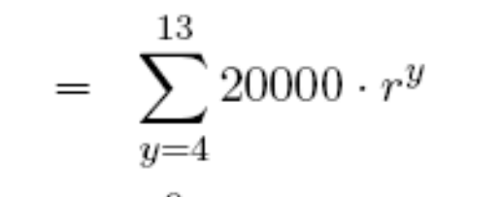

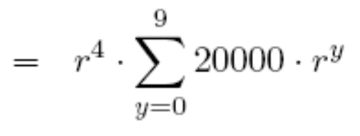

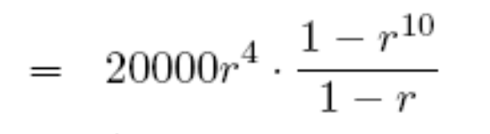

Plan A
Plan A: Wait four years, then repay $20,000 at the
start of each year for the next ten years.
Current value for plan A

Slide 35
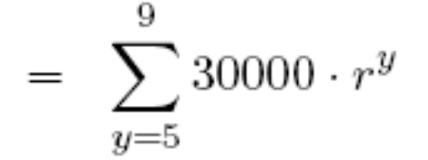
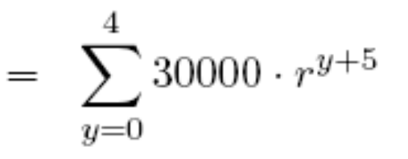
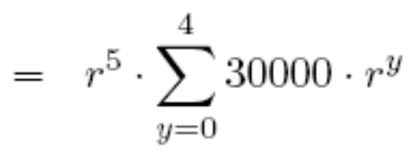
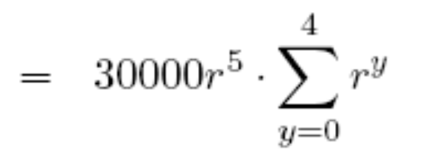
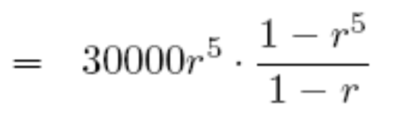

Plan B
Plan B: Wait five years, then repay $30,000 at the
start of each year for the next five years.
Current value for plan B

Slide 36
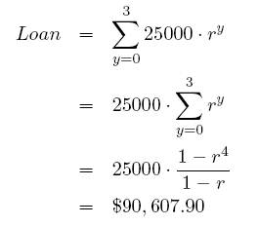
Profit
$25,000 at the start of each year for four years
to pay for your college tuition.
Loan office profit = $3233.

Slide 37
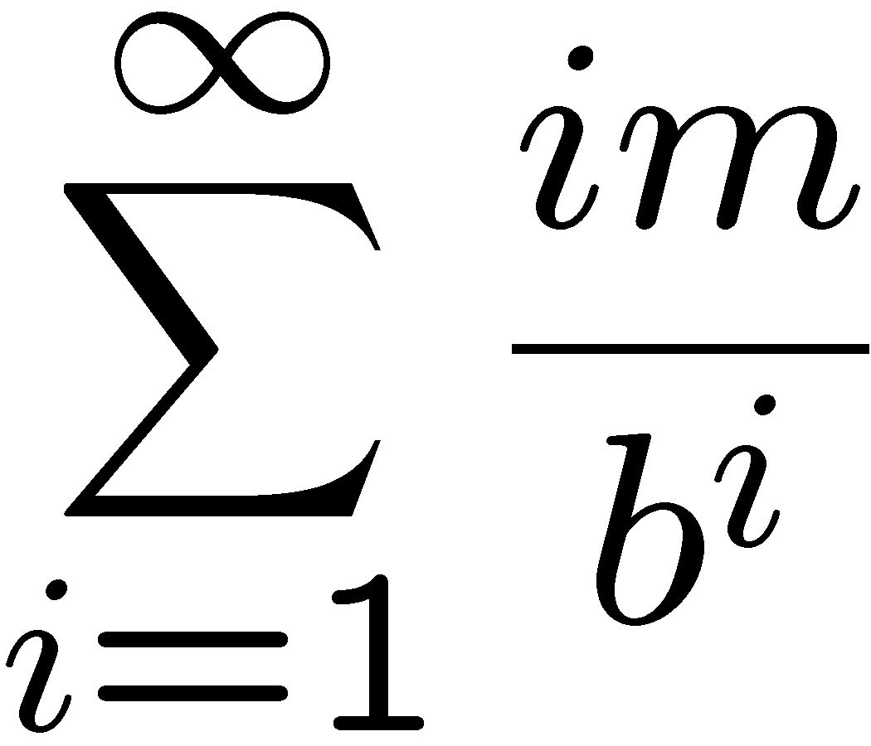
More Annuities
Suppose there is an annuity that pays i×m dollars at the end of each year i forever.
For example, if m = $50, 000, then the payouts are $50, 000 and then $100, 000 and then $150, 000 and so on…
What is a simple closed form expression of the following sum?
Recall:
$n paid k years from now
is only worth $n/b^{k} today
b is the bank rate

Slide 38
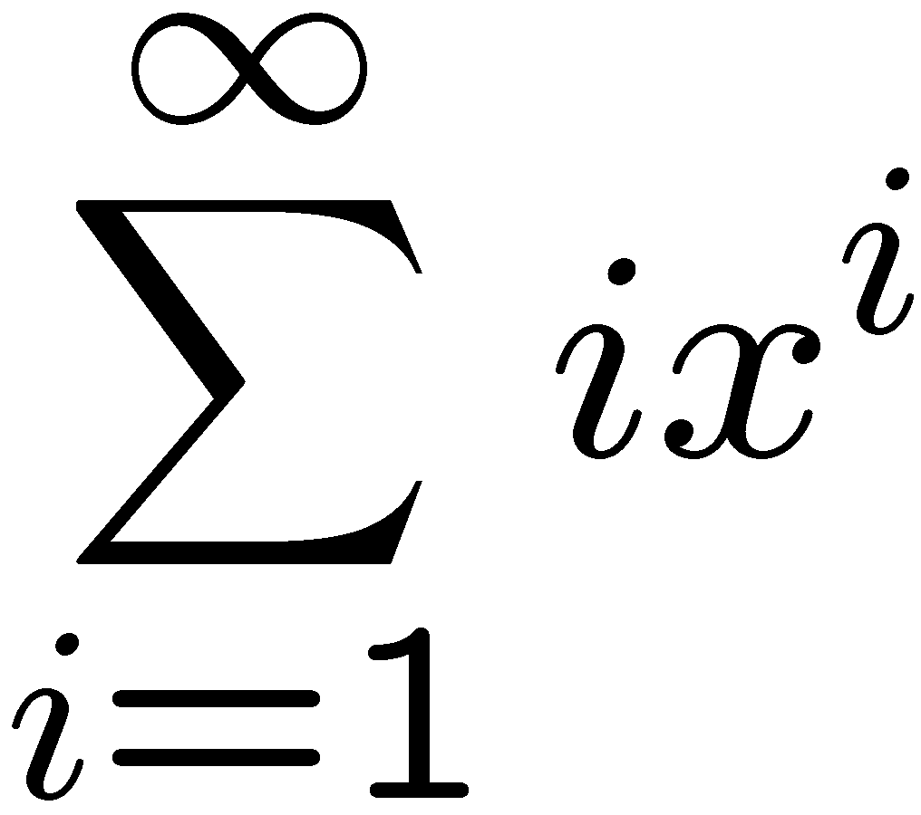
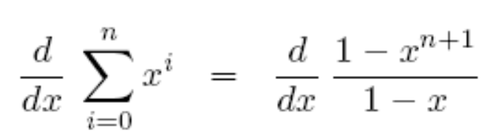

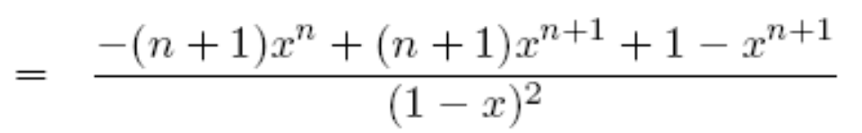
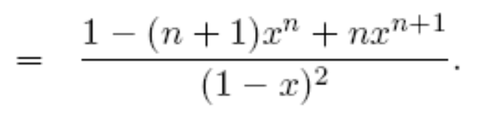
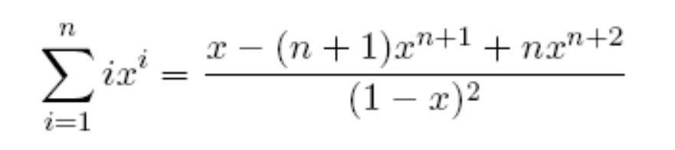
Manipulating Sums
What is a simple closed form expression of ?
(can also be proved by induction)

Slide 39

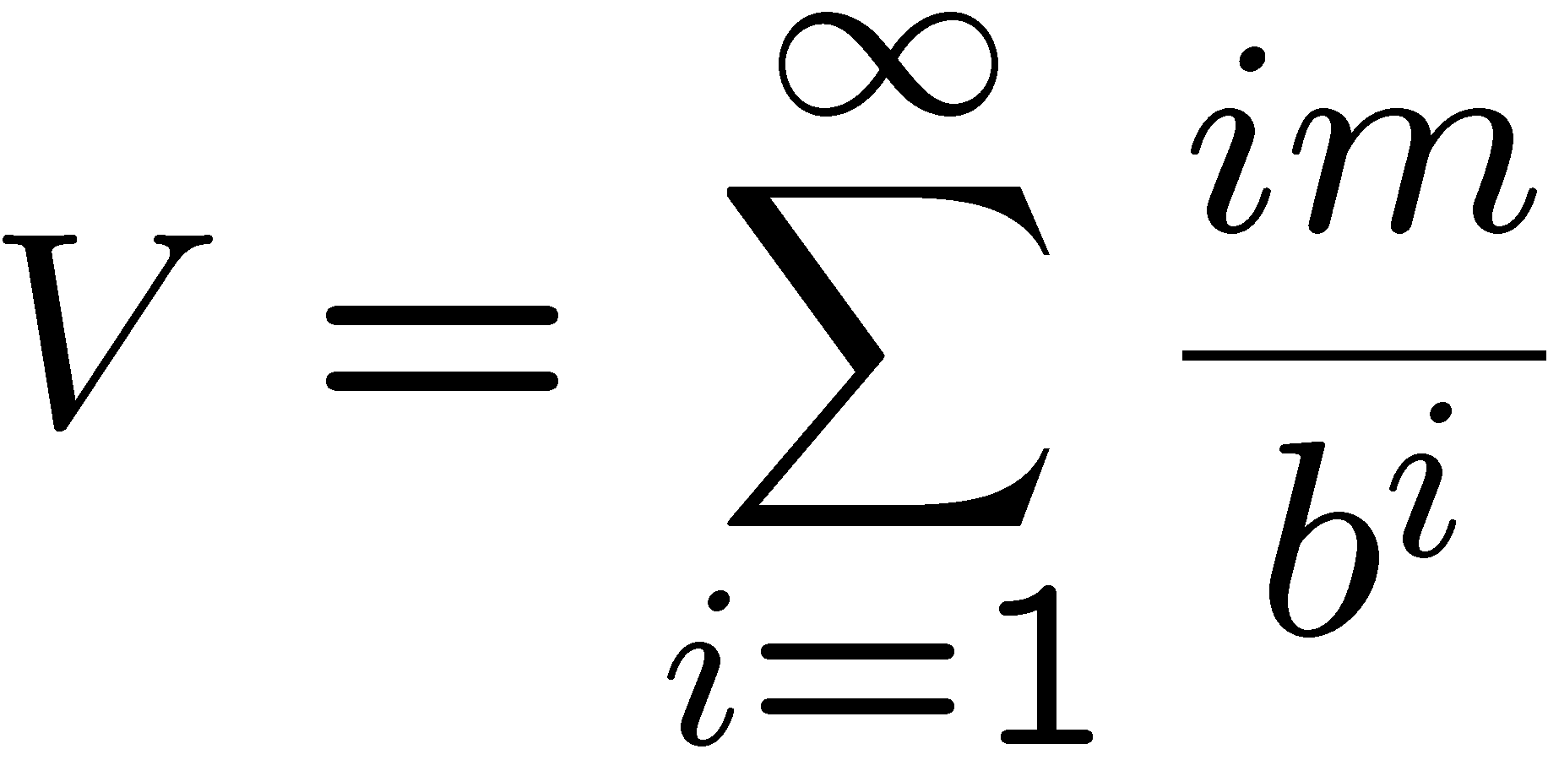
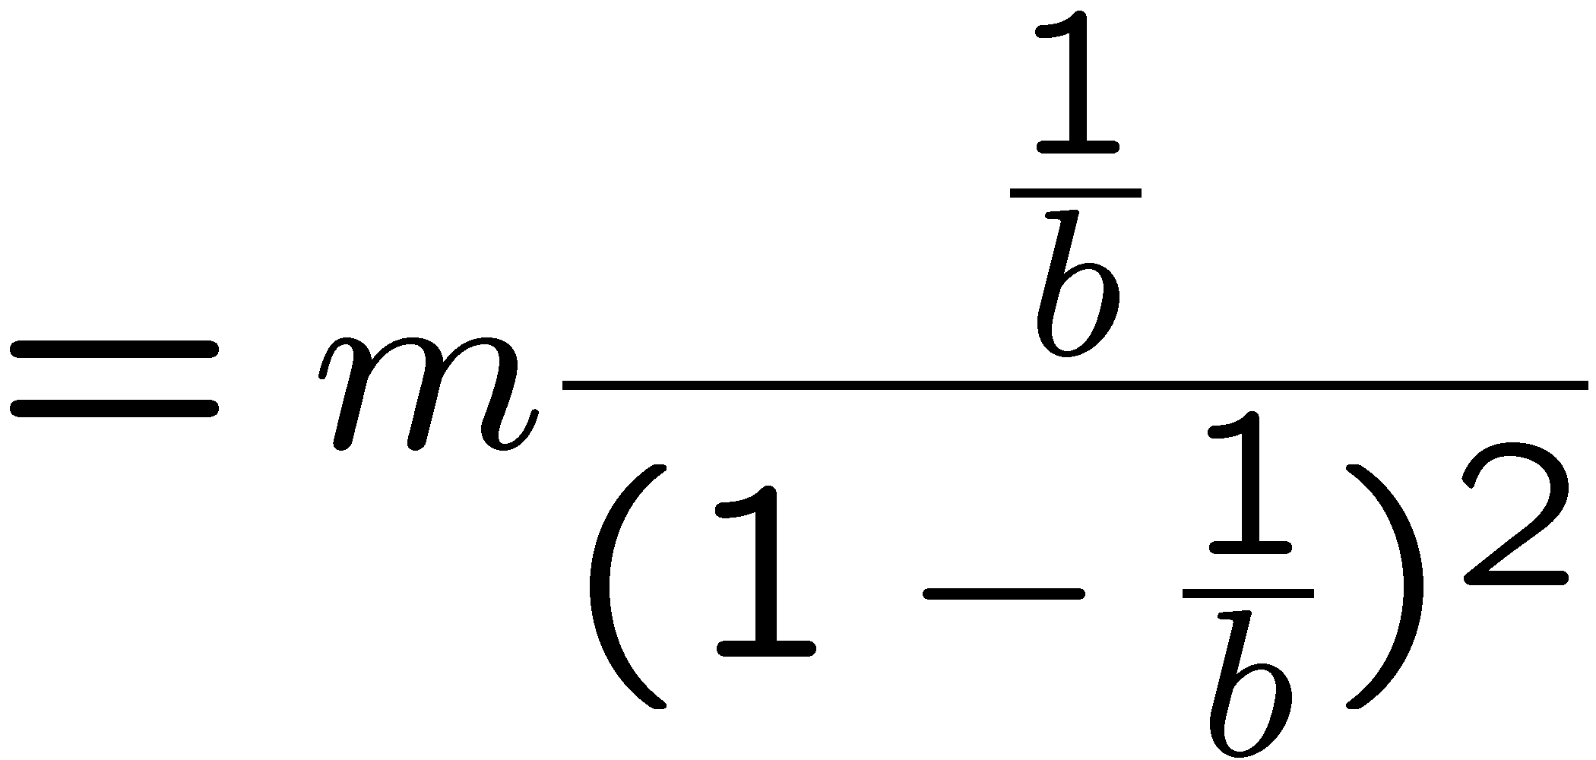
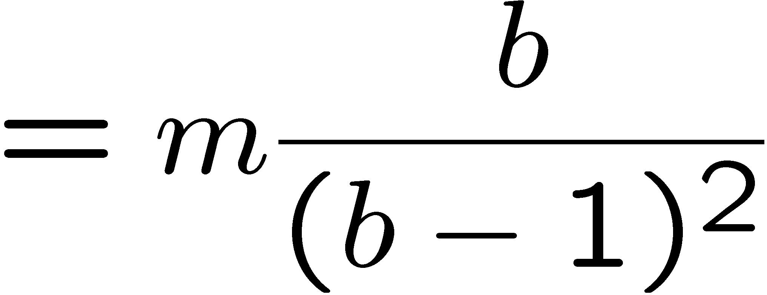
Manipulating Sums
for x < 1
For example, if m = $50, 000, then the payouts are $50, 000 and then $100, 000 and then $150, 000 and so on…
For example, if b=1.08, then V=8437500.
Still not infinite! Exponential decrease beats additive increase.

Slide 40
This Lecture
Representation of a sequence
Sum of a sequence
  Arithmetic sequence
  Geometric sequence
    Applications
  Harmonic sequence
  The integral method
Product of a sequence
  Factorial

Slide 41
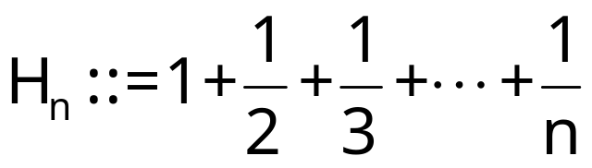

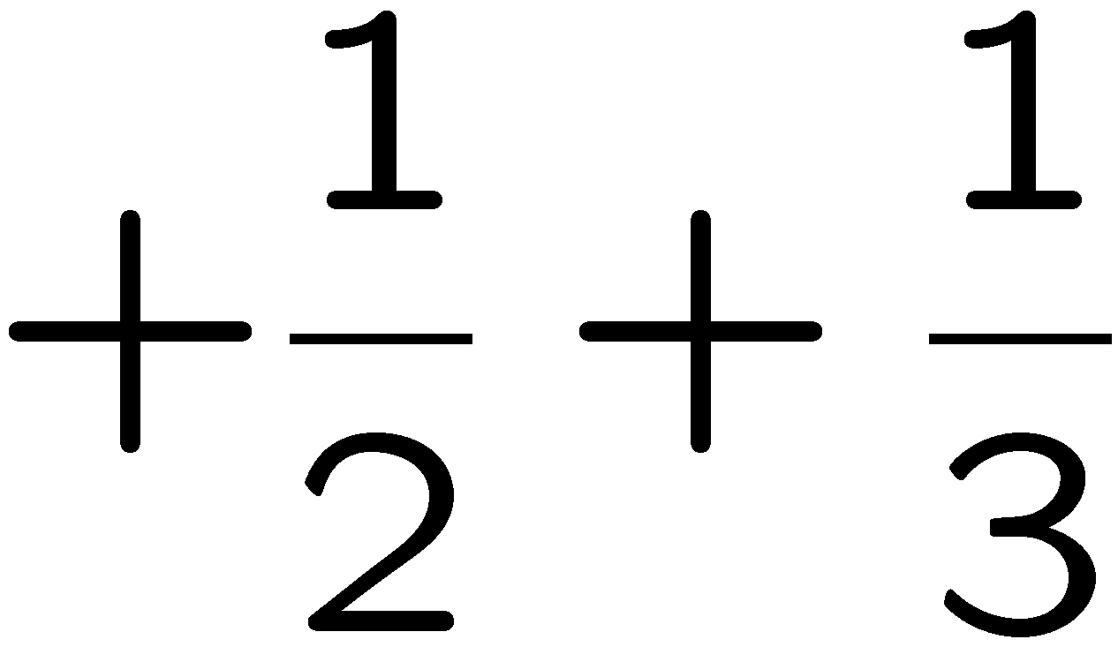
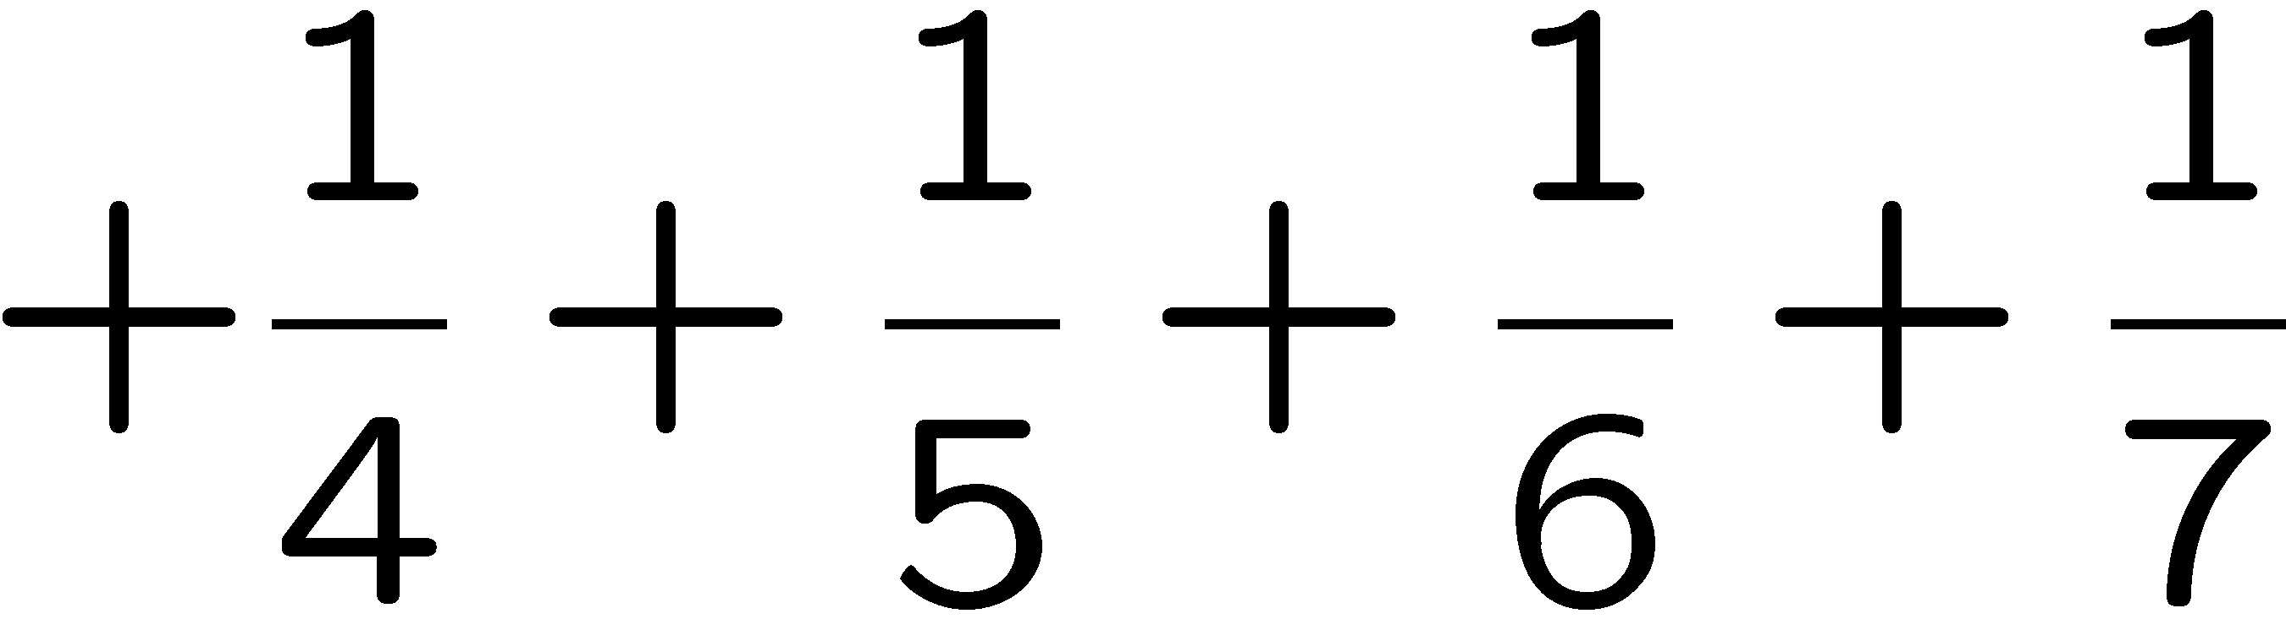
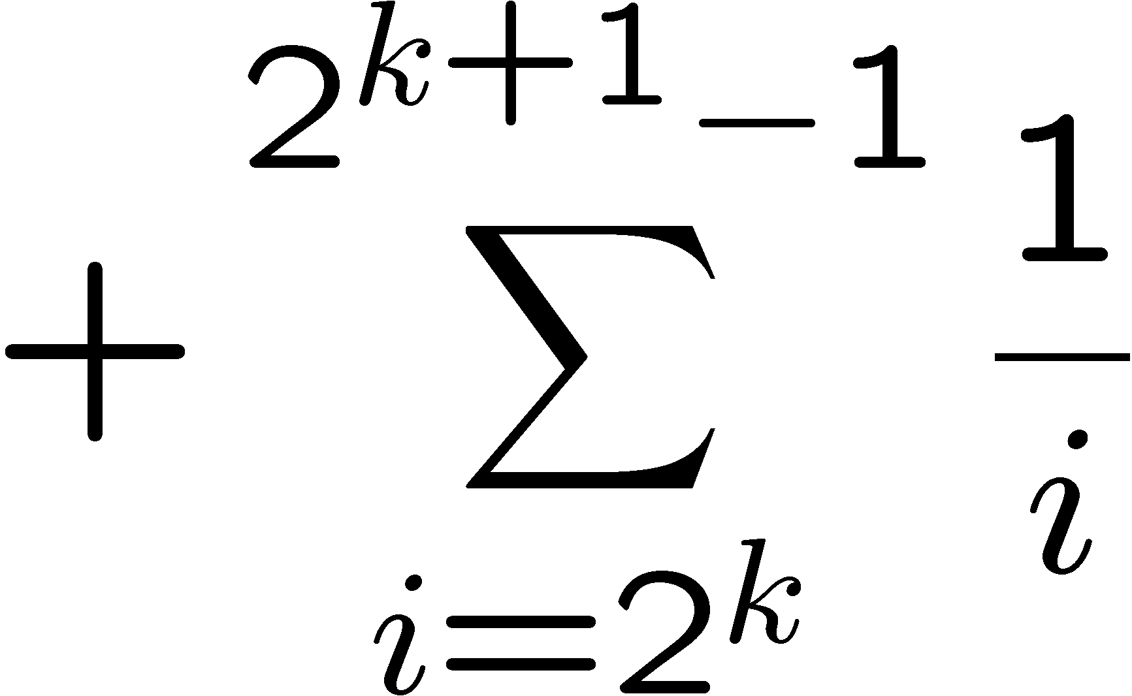
Harmonic Number
How large is
?
Row 1
1 number
2 numbers, each <= 1/2 and > 1/4
Row 2
Row sum is <= 1 and >= 1/2
Row 3
4 numbers, each <= 1/4 and > 1/8
…
Row sum is <= 1 and >= 1/2
…
Row k+1
2^{k} numbers, each <= 1/2^{k} and > 1/2^{k+1}
Row sum is <= 1 and >= 1/2
…
The sum of each row is <=1 and >= 1/2.

Slide 42



Harmonic Number
How large is
?
Row 1
k rows have totally 2^{k}-1 numbers.
How:
Row 2
If n is between 2^{k} and 2^{k+1}-1,
there are >= k rows and <= k+1 rows,
and so the sum is at least k/2
and is at most (k+1).
Row 3
…
…
Row k+1
…
The sum of each row is <=1 and >= 1/2.

Slide 43
This Lecture
Representation of a sequence
Sum of a sequence
  Arithmetic sequence
  Geometric sequence
    Applications
  Harmonic sequence
  The integral method
Product of a sequence
  Factorial

Slide 44

Harmonic Number
1
1
x
1
x+1
1
2
1
3
1
1
2
1
3
0 1 2 3 4 5 6 7 8

Slide 45


Harmonic Number
1
1
x
1
x+1
1
1
2
1
3
0 1 2 3 4 5 6 7 8

Slide 46
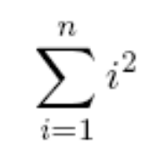
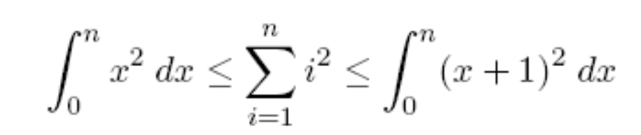



More Integral Method
What is a simple closed form expressions of ?
Idea: use integral method.
So we guess that
Make a hypothesis

Slide 47






Sum of Squares
Make a hypothesis
Plug in a few value of n to determine a,b,c,d.
Solve this linear equations gives a=1/3, b=1/2, c=1/6, d=0.
Go back and check by induction if

Slide 48
This Lecture
Representation of a sequence
Sum of a sequence
  Arithmetic sequence
  Geometric sequence
    Applications
  Harmonic sequence
  A general method
Product of a sequence
  Factorial

Slide 49







Product

Slide 50







Factorial
Factorial defines a product:
How to estimate n!?
Too rough…
Still very rough

Slide 51

Factorial
Factorial defines a product:
How to estimate n!?
Turn product into a sum taking logs:
ln(n!) = ln(1·2·3 ··· (n – 1)·n)
= ln 1 + ln 2 + ··· + ln(n – 1) + ln(n)

Slide 52
Integral Method
ln n
ln (x)
ln (x+1)
ln 5
ln 4
ln 3
ln
n-1
ln n
ln 5
ln 2
ln 4
…
ln 3
ln 2
1
2
3
4
5
n–2
n–1
n

Slide 53





Integral Method
Just FYI:
Stirling’s formula:
⇒
Integrating…
⇒
Exponentiating…

